Slide 1
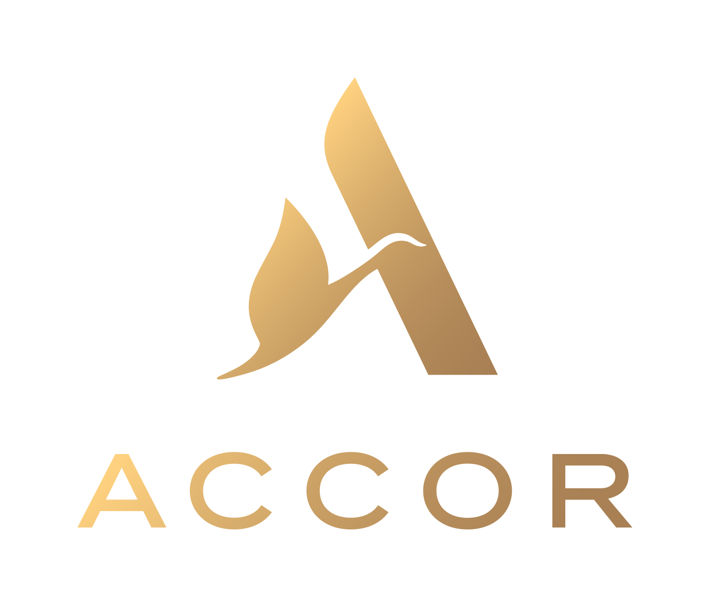
Case Study: Accor
(Senegal, Cote d’Ivoire, Cameroon, Ghana, Nigeria, South Africa, Madagascar, DRC, Togo, Benin, Chad, Equatorial Guinea, Morocco, Algeria, Tunisia)
THE CHALLENGE
INSIGHT & STRATEGY
EXECUTION / SOLUTION / INNOVATION
With hotels in several African countries, how can we centralize the digital communication in 15 countries while considering the realities and commercial actions of each hotel (ibis, Pullman, Sofitel, Novotel, etc.)?
According to data provided by Accor, there is an imbalance between the traffic in the Maghreb VS Sub-Saharan Africa. In addition, the Accor brand is very little known in the latter, an impact on its notoriety on the continent.
We built a team of 8 people expert in digital communication based in Abidjan.
Making frequent trips to Casablanca to meet the customer (Africa Hub of the Accor Group). Definition of process with the communication managers of the various hotels and coordination of global and local campaigns with the Hub.
Creation of acquisition campaigns (reservation) and loyalty campaigns (Le Club Accor Hotels).
Result / Business Effect
25,000,000+ Reach,
72,000,000+ Impressions,
400,000+ Engagements
80,000+ fans
Notes:
The world we live in has changed – driven by data, technology and a shift in peoples expectations of marketing.
This change demands us to revisit and transform how businesses, marketing and communications operate, and establish new approaches to build relationship with consumers.
Our world has shifted from one of product out, advertising supply, and media disruption, into a consumer demand led market. If a business fails to deliver against these new rules, new expectations, then they will never win.
In this on-demand economy, attention is at a premium. Information is a commodity and decisions to buy or not, are made based on a series of conscious and sub-conscious triggers. Marketing seeks order, however, decisions are made in chaos. So, while marketing looks for the linear, we believe in loops.
Marketing needs to be redefined. It is now required to attract, acquire, convert and, crucially, retain customers. Seamlessly and efficiently. It means the experience of marketing is critical for brands to succeed.
Clients increasingly demand integrated and addressable marketing plans. Requiring the combination of human understanding, informed creativity, and a people based approach to data & technology. And agencies need to build their capability to guide clients in the way they interface with their customers and prospects - making the vision of the seamless, relevant brand experience a reality.
Agencies need to command a superior understanding of not simply people’s behavior through data, but their values and motivations to truly understand emerging consumer expectations.
And dentsu X has been built exclusively for this challenge.

