Slide 1
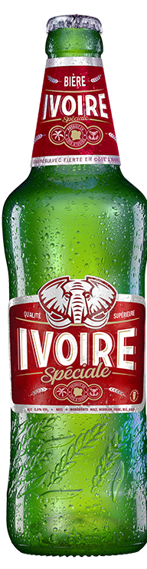
Brassivoire (Heineken)
Avoid cannibalization between 2 products of the same brand

Slide 2
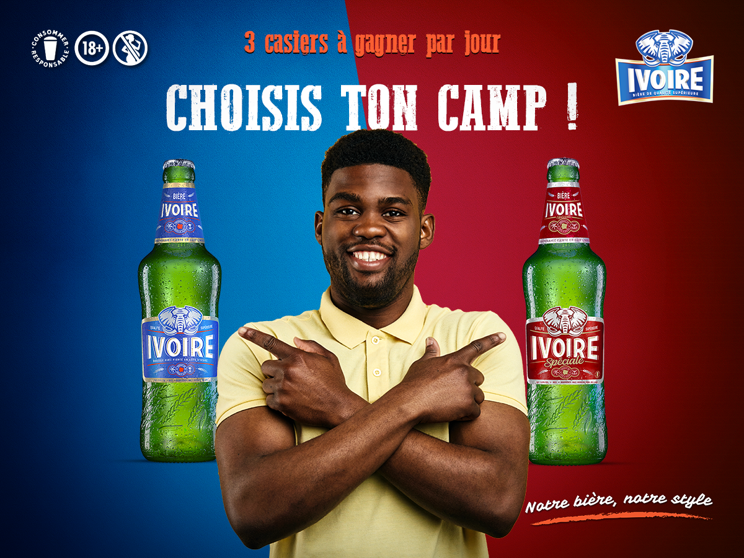
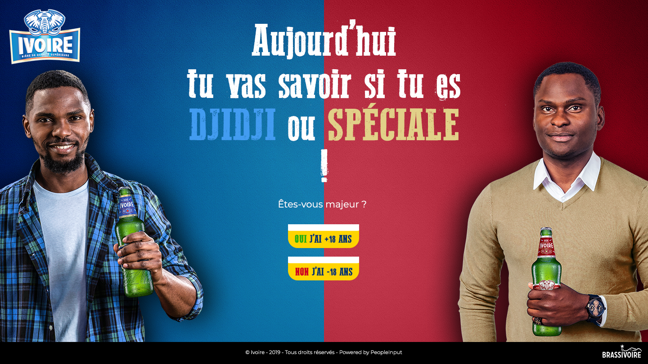
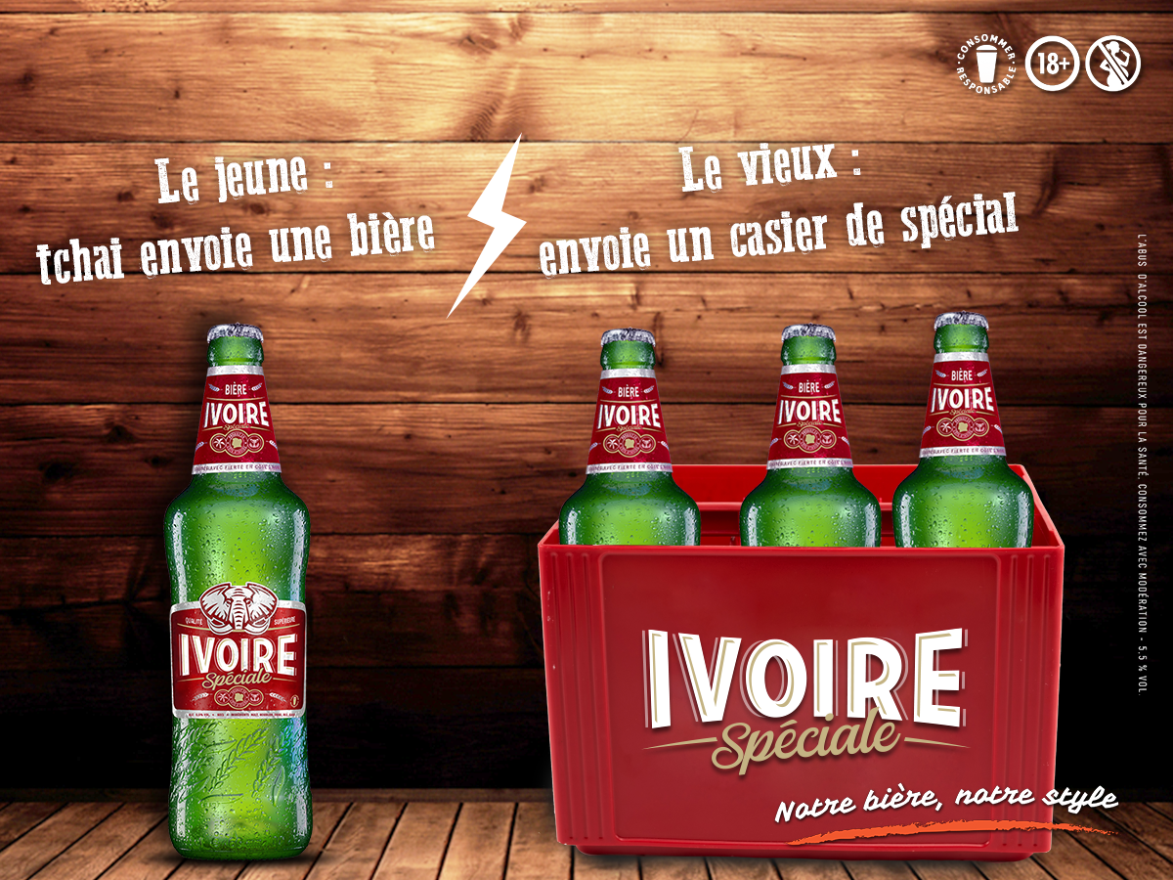
The challenge
With the launch of the new Ivoire Spéciale beer, how can consumers understand the difference between Ivoire Classic and Ivoire Spéciale? And also that they adopt the new beer.
The solution
A 3 phases strategy with 1st making the public know about the new beer (awareness), then in second launch a digital activation called “Guere Fraiche” which is kind of a war between the 2 beers and asking fans to choose a side after filling a survey.
And finally, a 3rd step with brand contents and giveways to the fans.

Slide 3
Brassivoire – Heineken (Cote d’Ivoire)
Built a landing page for the launch of Ivoire Speciale.
By encouraging consumers to answer 5 questions about their beer consumption habit, the platform defines their profile between Ivoire Classic (the blue one) and Ivoire Spéciale (the red one).
This platform was set up to avoid cannibalization between the 2 products.
Result / Business Effect
1,200,000+ Reach,
11,000,000+ Impressions,
130,000+ Engagements,
15,000+ Clicks,
6,600+ participated to the game

