Slide 1
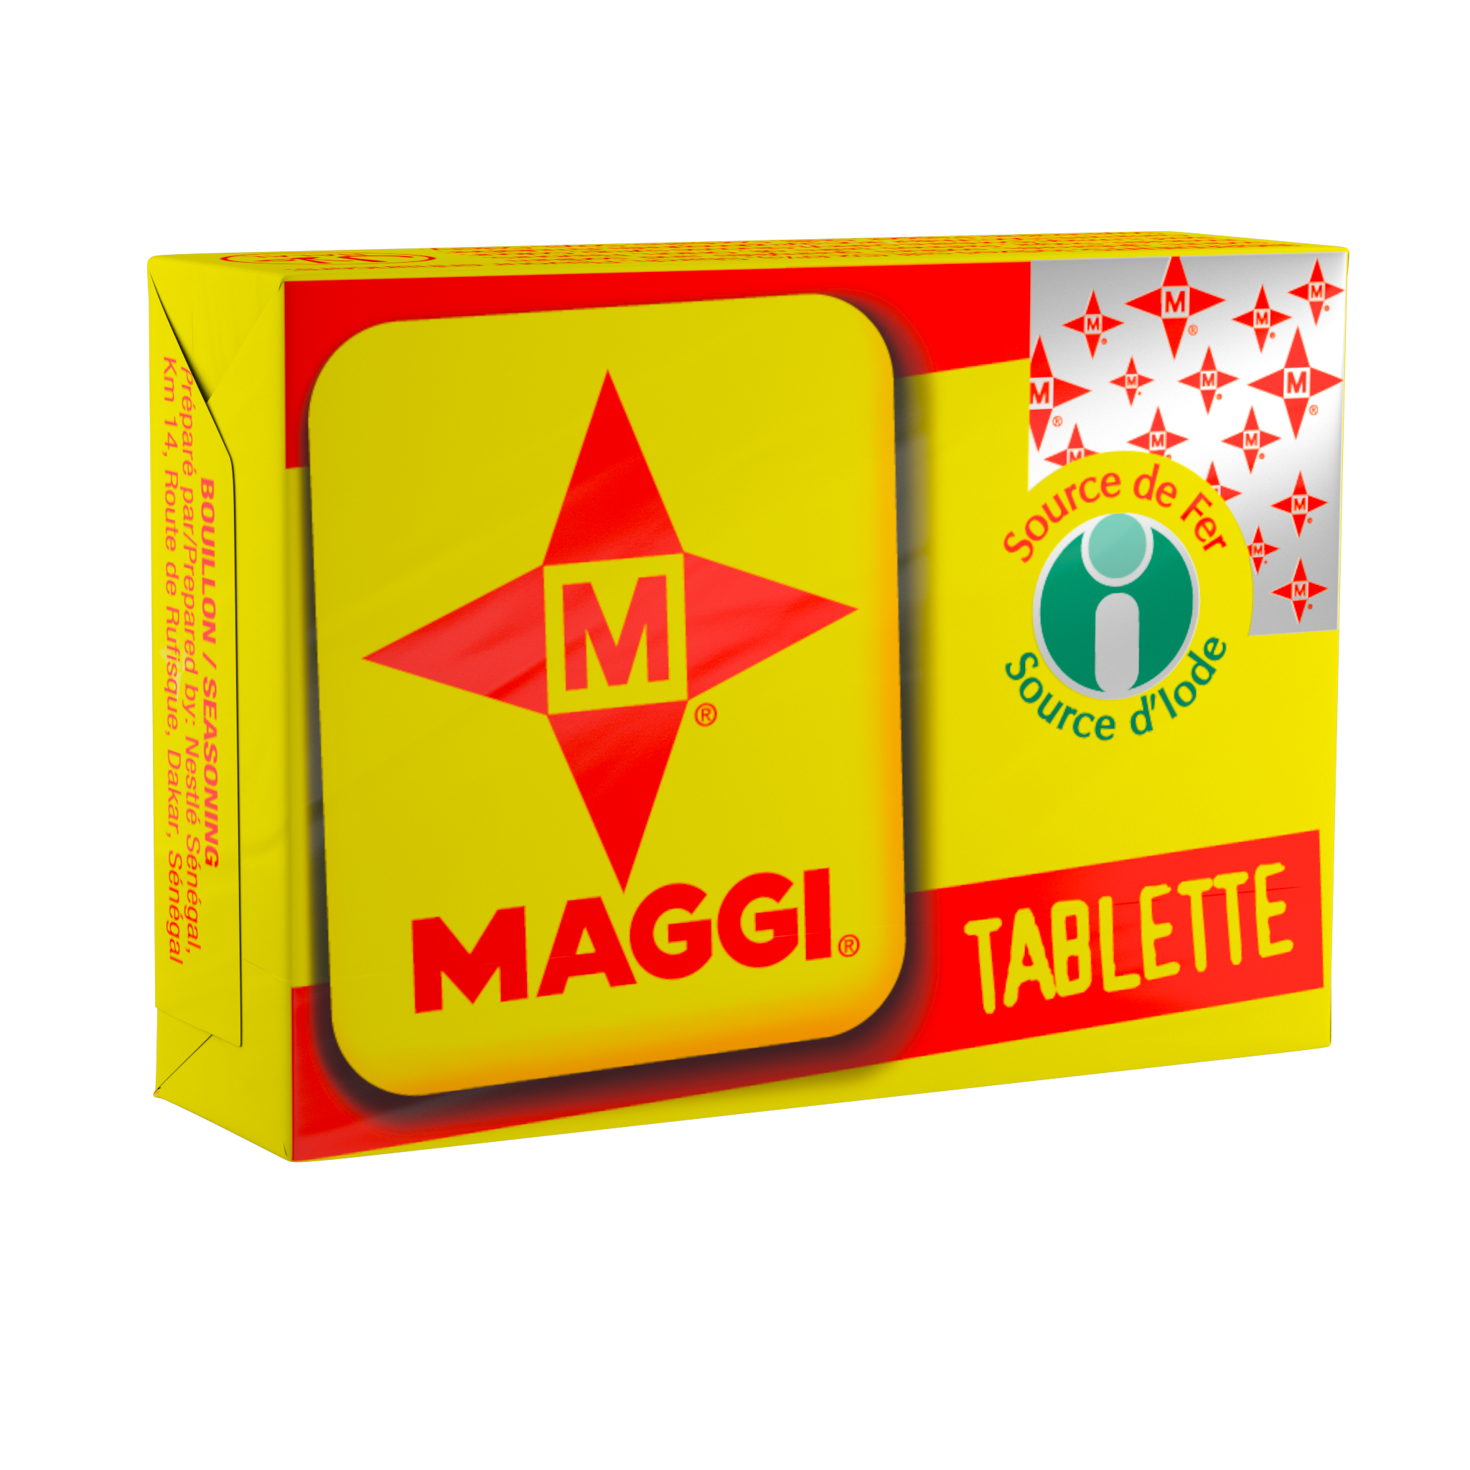
Maggi
Support senegalese women during the Ramadan with easy and yummy recipes

Slide 2
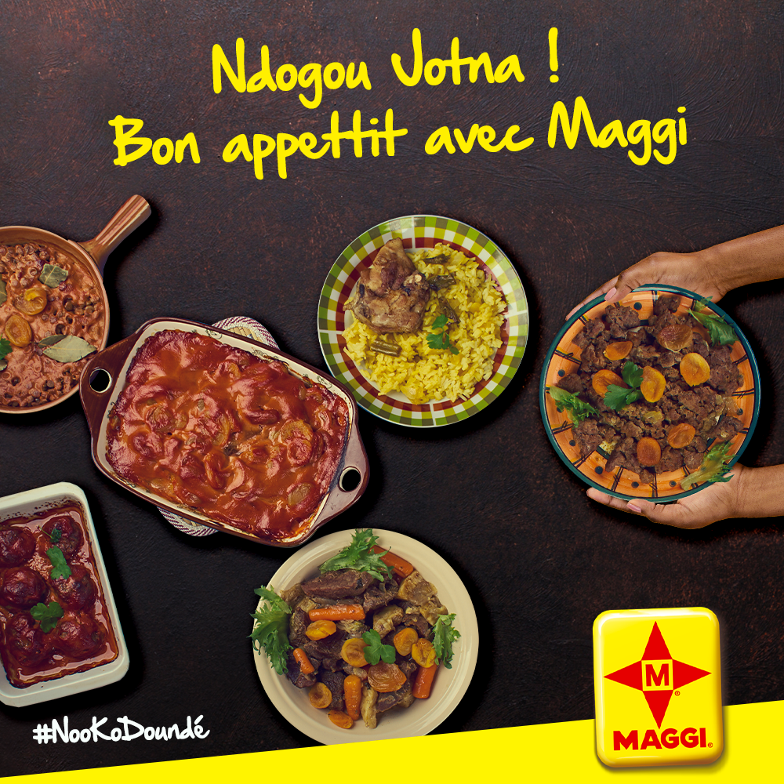
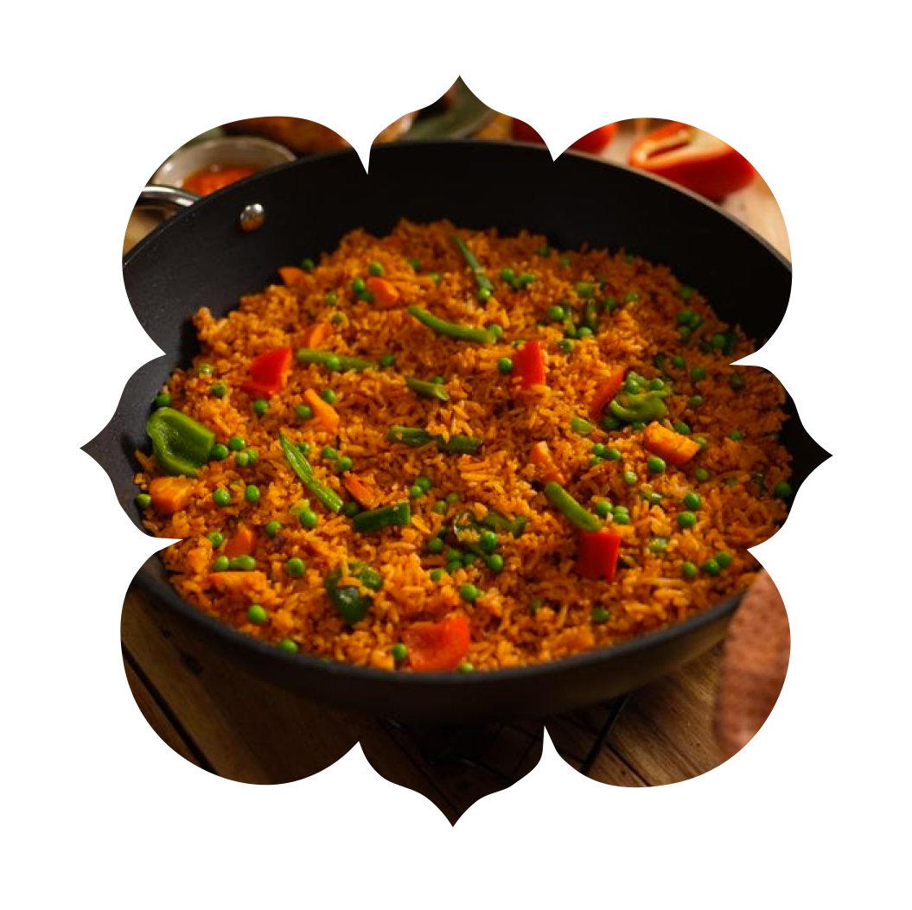
The challenge
2020 Ramadan was quite different from the others in the way that the world were into Covid19 context. Many countries put some restrictions such as lockdown or limited circulation. In this context, how can Maggi be present in women’s life when people were a lot more connected ?
The solution
We come up with the concept “Nenu Togg Sunu Keur” in wolof which means “let us stay home”. But the word “togg” in wolof has 2 senses : to cook and to stay. It’s a way to tell the clients that they can stay home safe and still cook good meals to their family.
We put the concept to reality with a website where clients can find recipes from many africans countries. Every day of the Ramadan, the platform reveals a new meal and the recipe. We also added the prayer of the day to stay in the context of the Ramadan.

Slide 3
Featured Work: Maggi (Senegal)
A video made with one influencer.

Slide 4
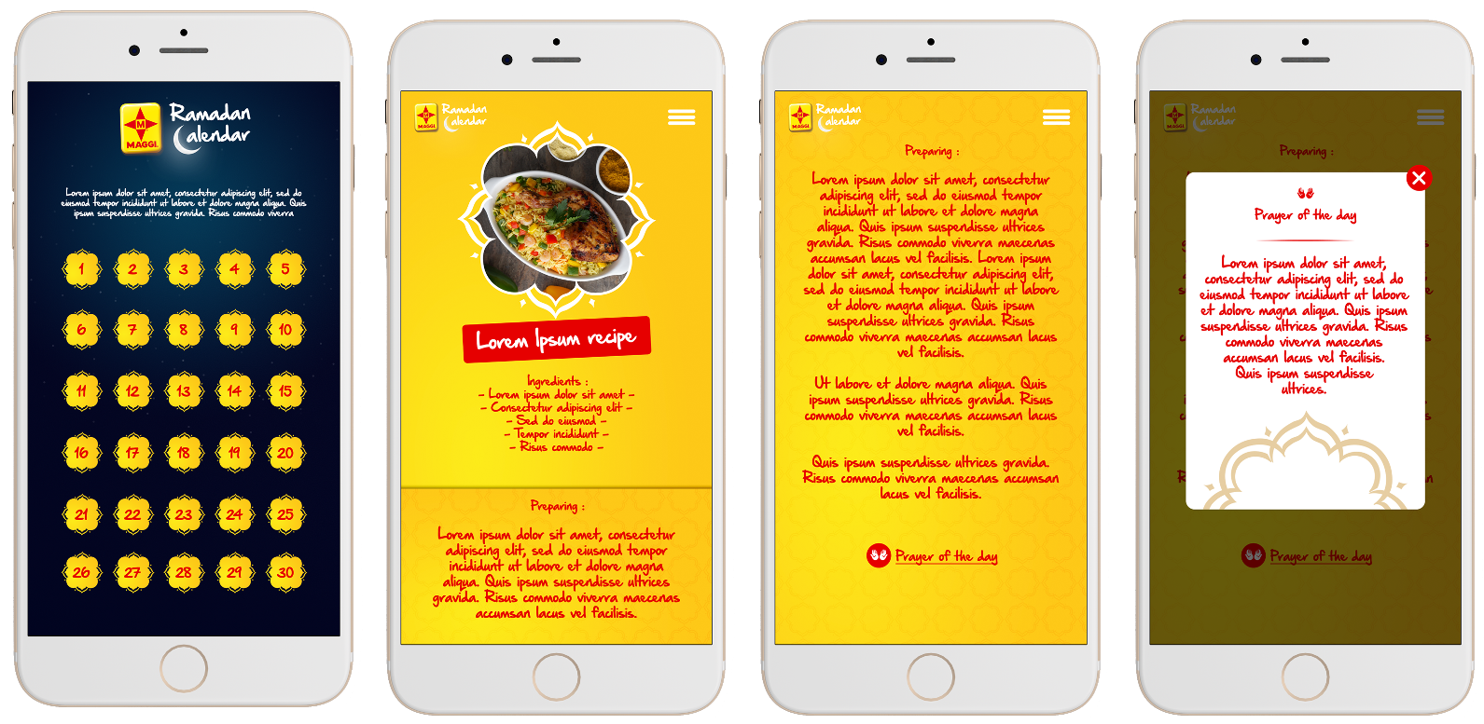
Featured Work: landing page for Ramadan (Senegal)
Ramadan Calendar website was created to help women find food recipes during the month of Ramadan. Each day, 1 new recipe was unveiled, and it was accompanied by the prayer of the day.
www.nenutoggsunukeur.com

