Slide 1
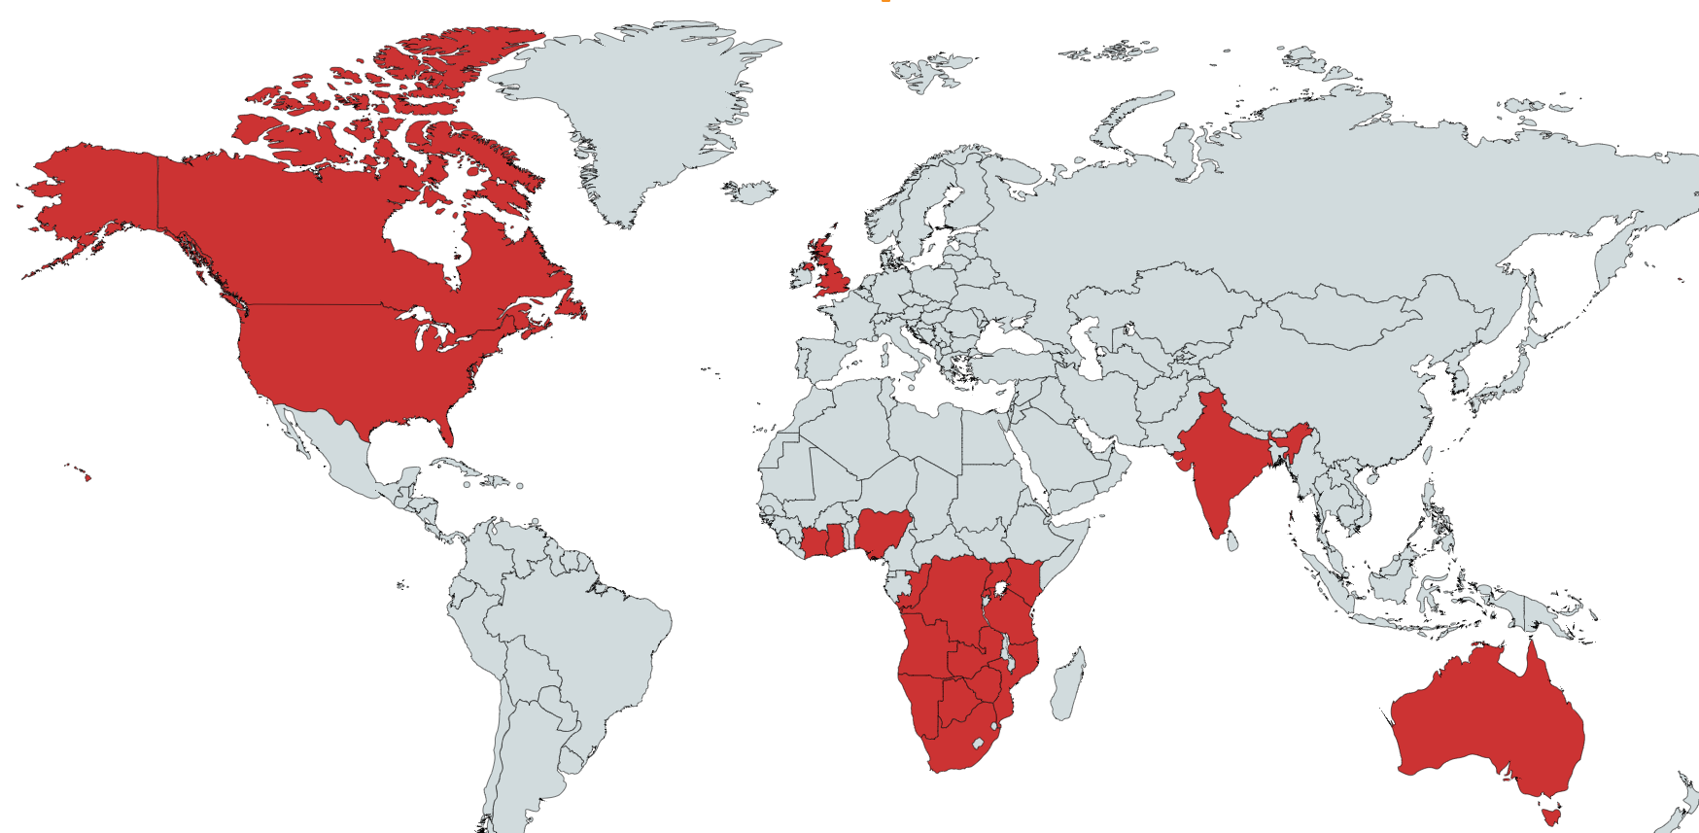
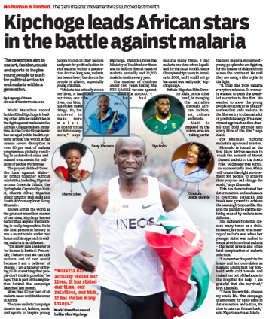
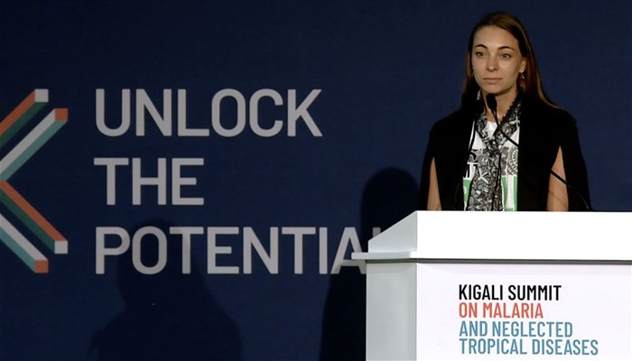
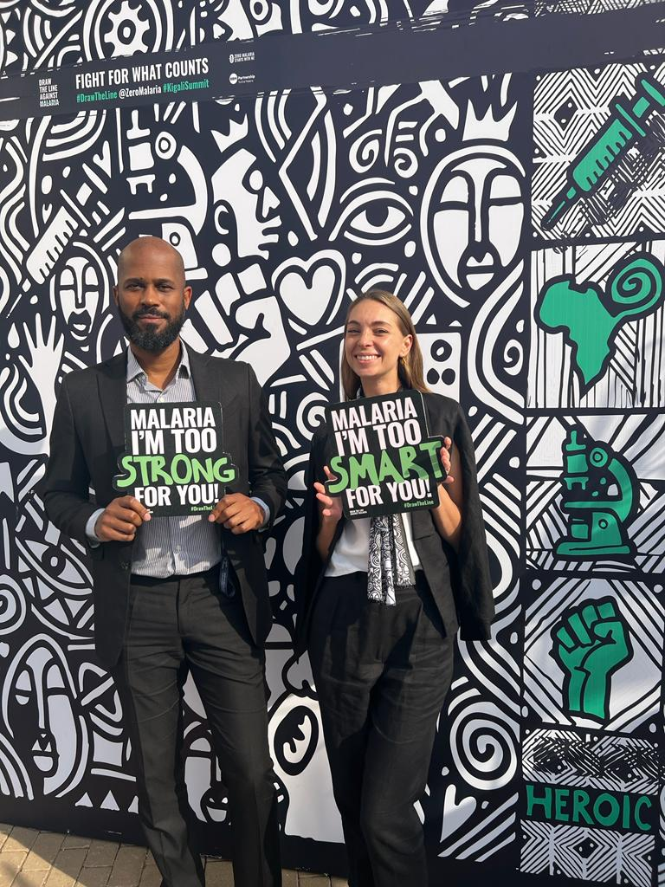
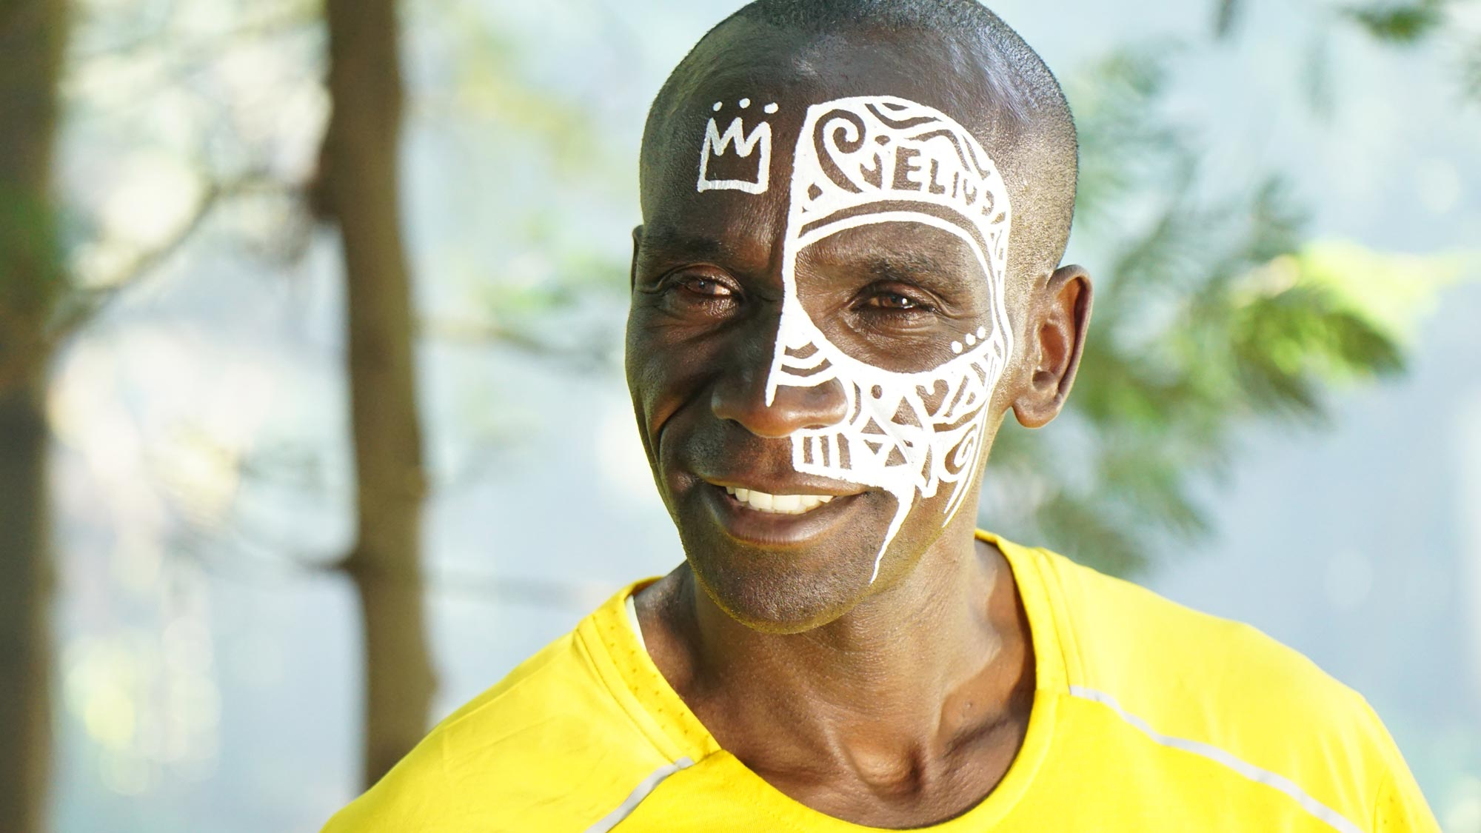
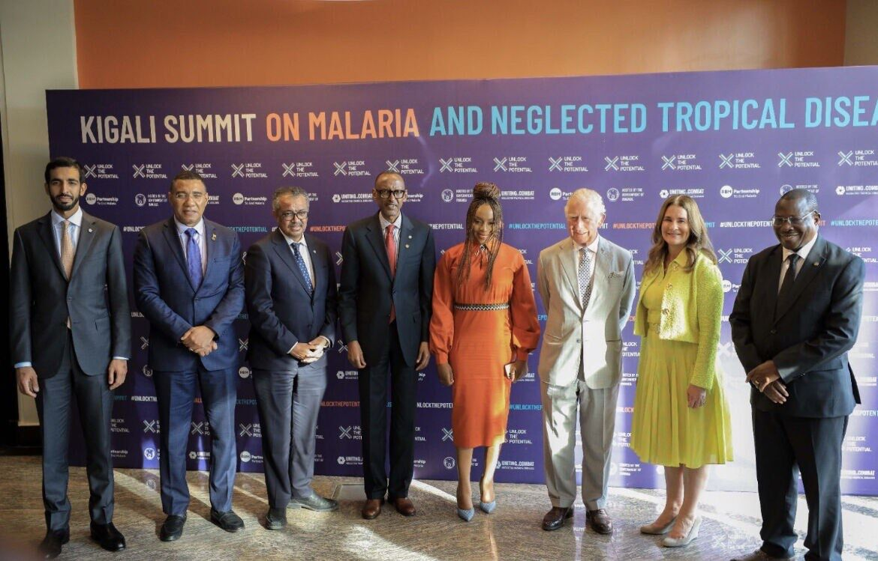
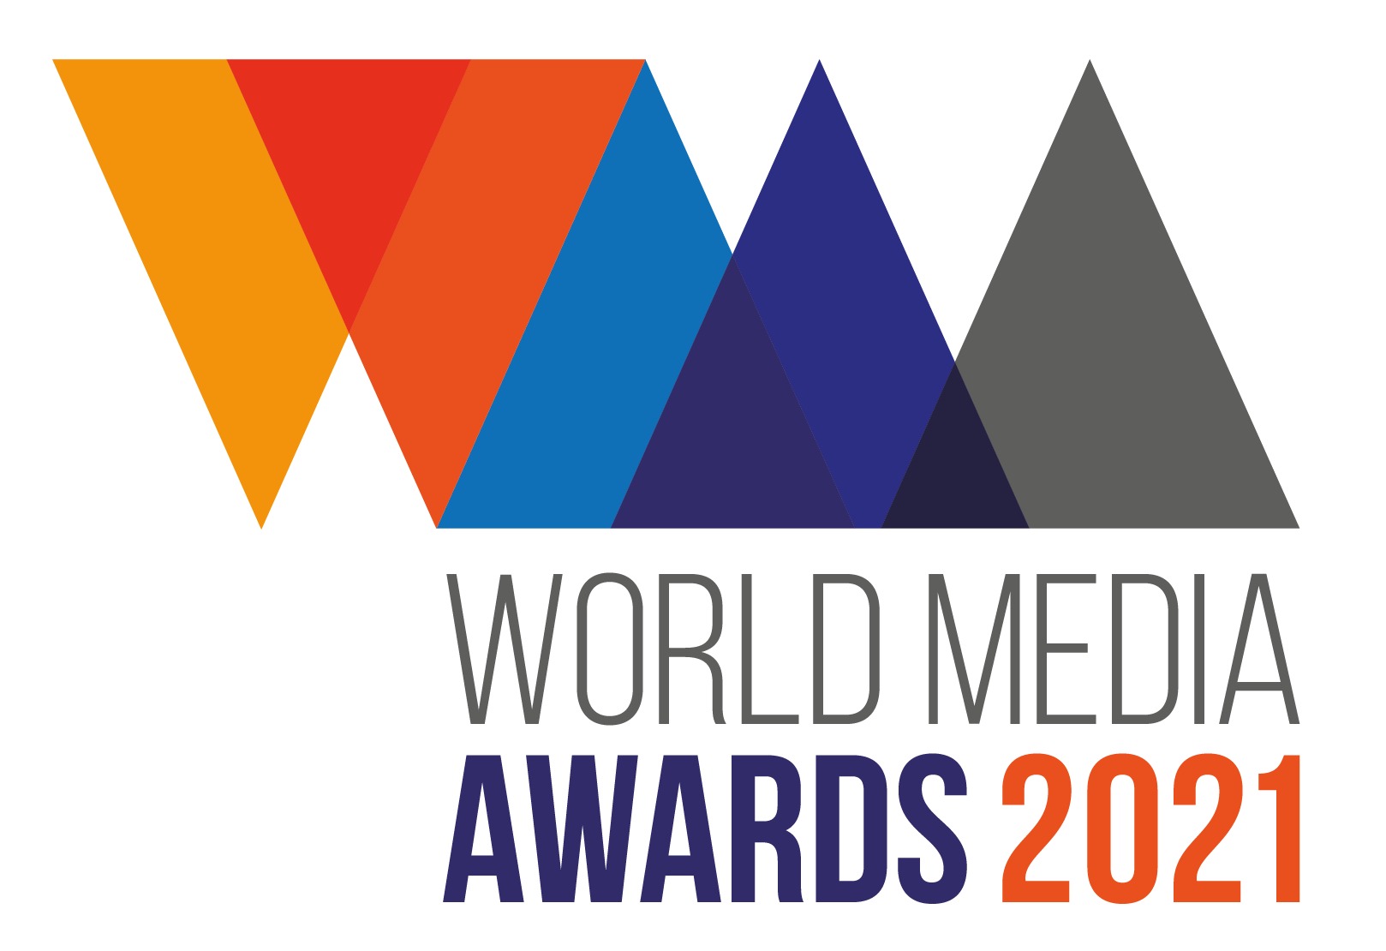
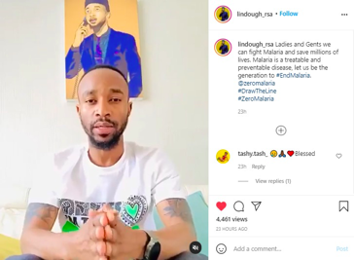
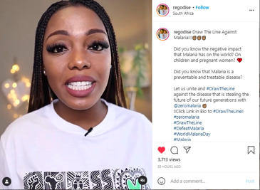
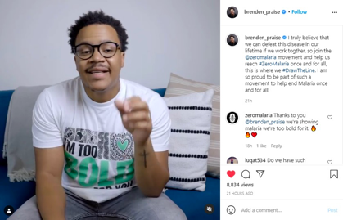
$5 Million+
of pro-bono media value worldwide
REACHING
1 BILLION +
PEOPLE
Exceeded Reach Objectives
Recruited Key Celebrities to the Cause
Achieved Government Commitments
Raised the Cause to World Leaders at CHOGM
Ignited a Malaria Youth Army
Created a Movement with the Muundo
Set a New Benchmark for Communications in Public Health
20+
LOCAL/GLOBAL AWARDS

Slide 2
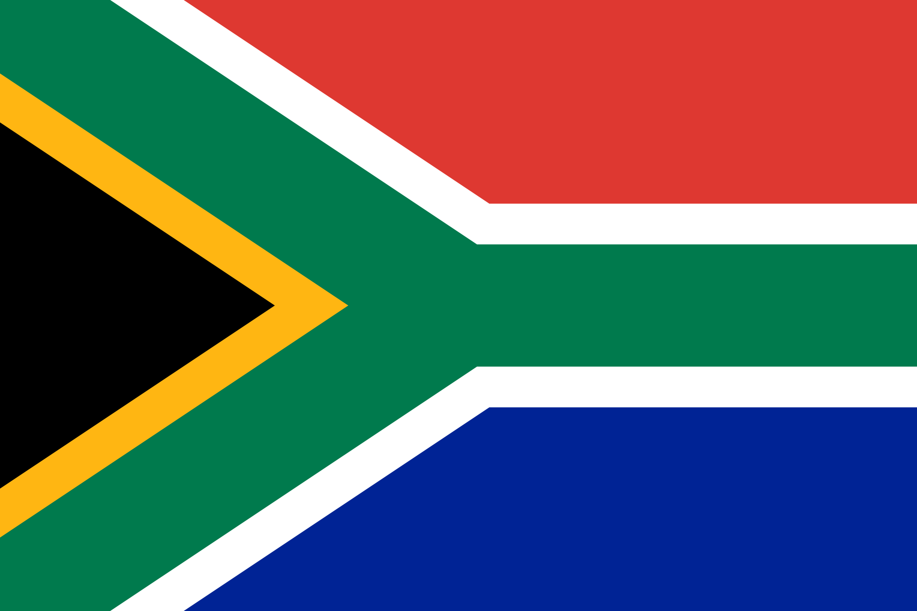
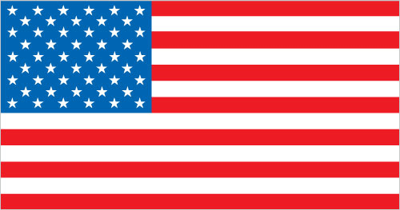
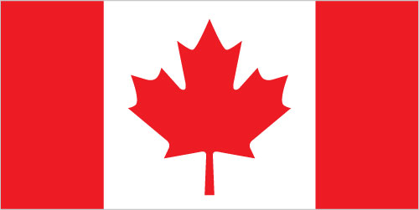
MALARIA NO MORE
A GLOBAL
ONE DENTSU
TEAM
RADICAL COLLABORATION
Malaria Partnership Coalition:
Roll Back Malaria (RBM) Partnership to End Malaria in collaboration with global malaria partners and a coalition of agencies and non-profit organisations, including the African Leaders Malaria Alliance (ALMA), the African Union Commission, The Bill & Melinda Gates Foundation, Speak Up Africa, Impact Santé Afrique, Malaria No More UK, and Goodbye Malaria.
MEDIA
(TRADITIONAL + DIGITAL)
PUBLIC RELATIONS
CREATIVE
BROADCAST
DIGITAL
19 CountrY TEAMS
100 Team Members
Statecraft, Tribeca, Illume, Grayling, BB Partners,
Creative – DENTSU, Láolú Senbanjo, Black Dog Films (part of Ridley Scott Creative Group), Wave Studios, Onesize, JM Films, Ginger Ink, Trim editing, TSE, Big Buoy
Paramount Africa,
DSTV
SuperSport
DENTSU Isobar
Firstborn
Whitespace
Meta
DENTSU

